Slide 1
Model-Agnostic Meta-Learning for Fast Adaptation of Deep Networks

Slide 2
Outlines
Background
Task Setup
Core Algorithm
Evaluation

Slide 3
Learn to Learn(aka Meta-Learning)
A key aspect of intelligence is versatility – the capability of doing many different things.
Current AI systems excel at mastering a single skill.
When you instead ask an AI system to do a variety of seemingly simple problems, it will struggle.
How can we enable our artificial agents to acquire such versatility?

Slide 4
Outlines
Background
Task Setup
Core Algorithm
Evaluation

Slide 5
Task Setup for Meta-Learning
The goal of few-shot meta-learning is to train a model that can quickly adapt to a new task using only a few datapoints and training iterations.
To accomplish this, the model is trained during a meta-learning phase on a set of tasks.
That is, the meta-learning problem treats entire tasks as training examples.

Slide 6
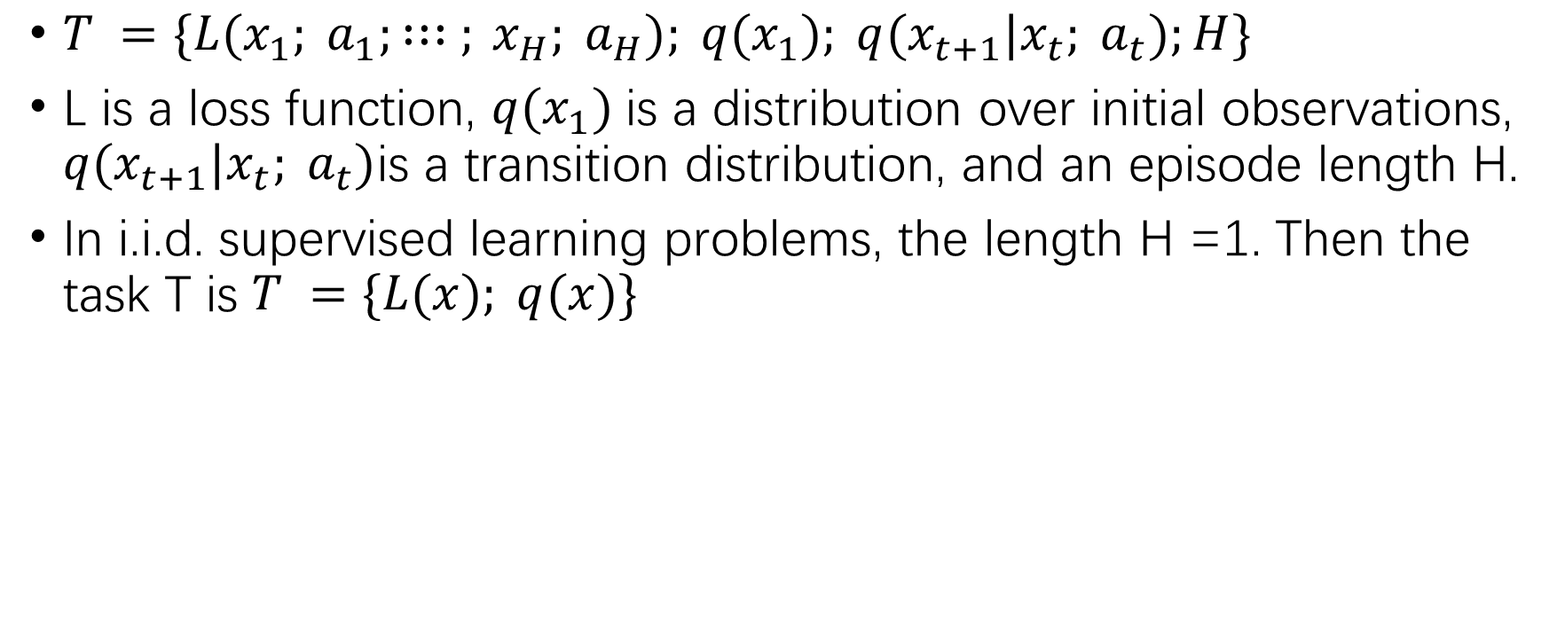
Task Setup for Meta-Learning
$T =\{L(x_{1}; a_{1}; : : : ; x_{H}; a_{H}); q(x_{1}); q(x_{t+1}|x_{t}; a_{t});H\}$
L is a loss function, $q(x_{1})$is a distribution over initial observations, $q(x_{t+1}|x_{t}; a_{t})$is a transition distribution, and an episode length H.
In i.i.d. supervised learning problems, the length H =1. Then the task T is $T =\{L(x); q(x)\}$

Slide 7
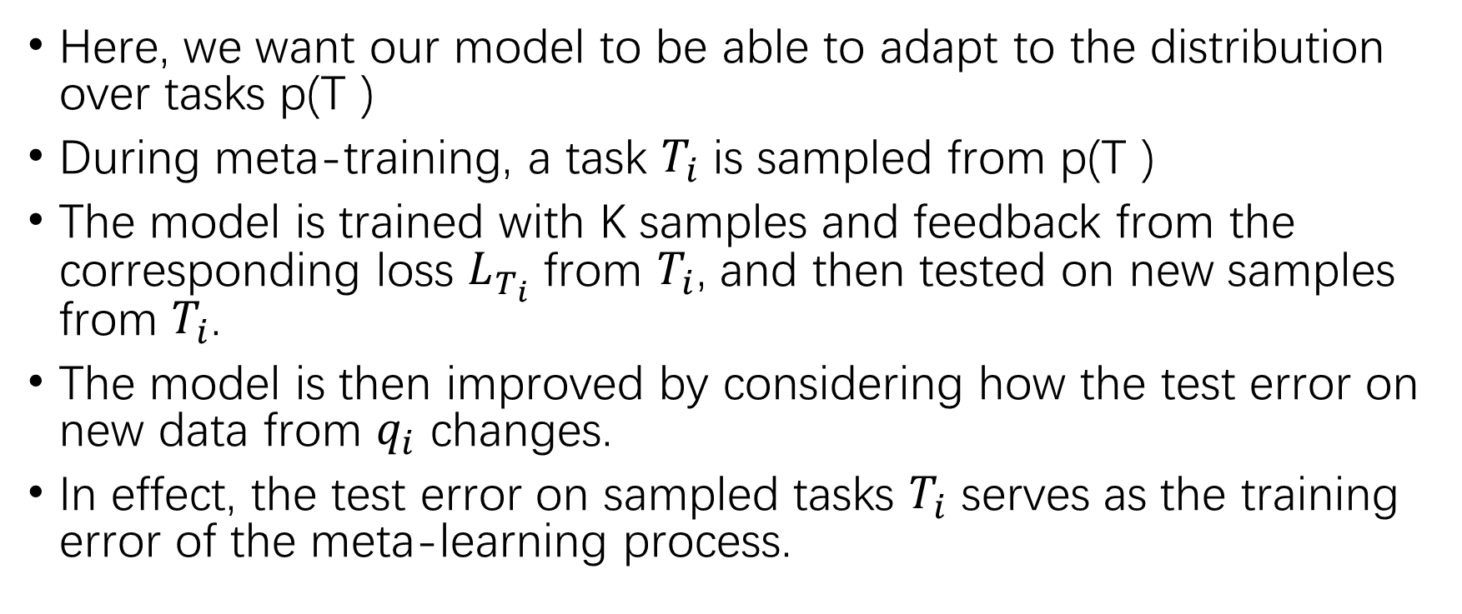
Task Setup for Meta-Learning
Here, we want our model to be able to adapt to the distribution over tasks p(T )
During meta-training, a task $T_{i}$ is sampled from p(T )
The model is trained with K samples and feedback from the corresponding loss $L_{T_{i}}$ from $T_{i}$, and then tested on new samples from $T_{i}$.
The model is then improved by considering how the test error on new data from $q_{i}$ changes.
In effect, the test error on sampled tasks $T_{i}$ serves as the training error of the meta-learning process.

Slide 8
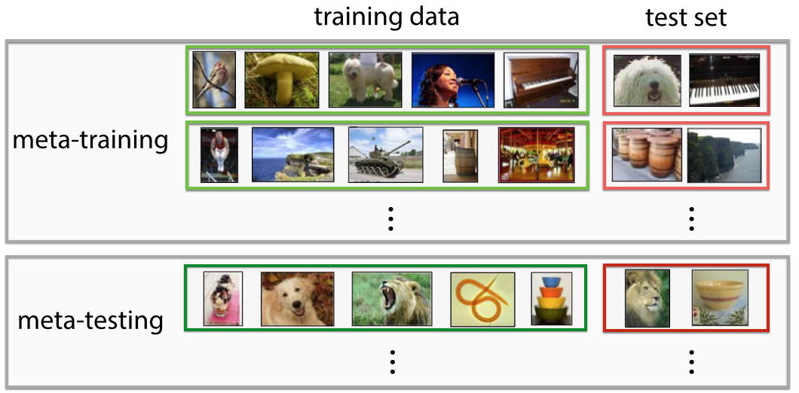
Task Setup for Meta-Learning

Slide 9
Outlines
Background
Task Setup
Core Algorithm
Evaluation

Slide 10
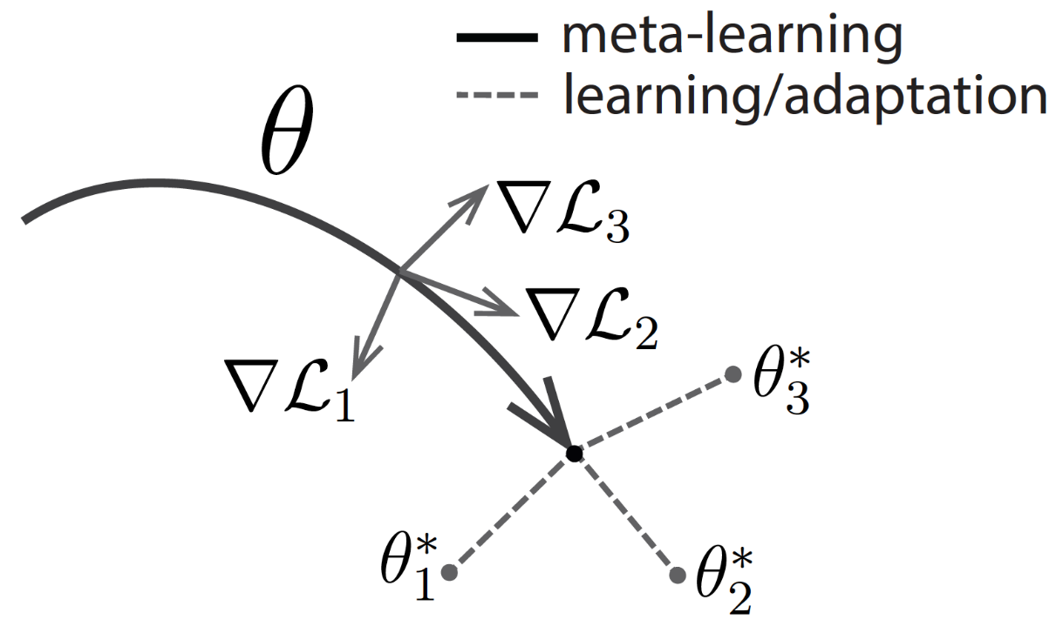
Core Algorithm
We take an explicit approach to this problem: since the model will be fine-tuned using a gradient-based learning rule on a new task, we will aim to learn a model in such a way that this gradient-based learning rule can make rapid progress on new tasks drawn from p(T).
In effect, we will aim to find model parameters that are sensitive to changes in the task, such that small changes in the parameters will produce large improvements on the loss function of any task drawn from p(T).

Slide 11
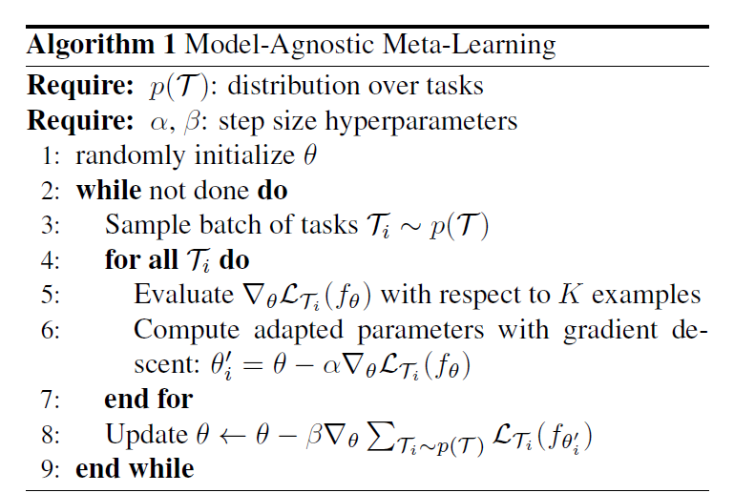
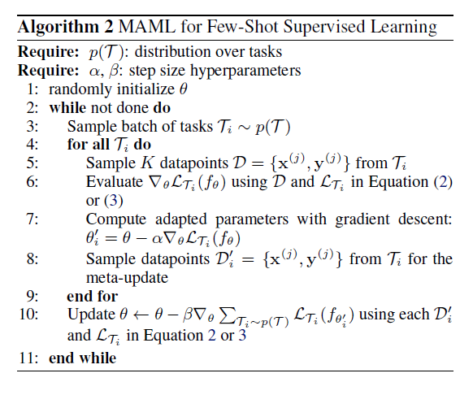
Core Algorithm

Slide 12
Outlines
Background
Task Setup
Core Algorithm
Evaluation

Slide 13
Evaluation
Regression
Classification
Reinforcement Learning

Slide 14
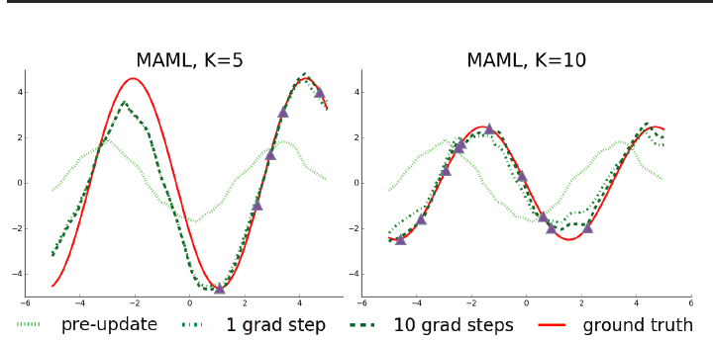
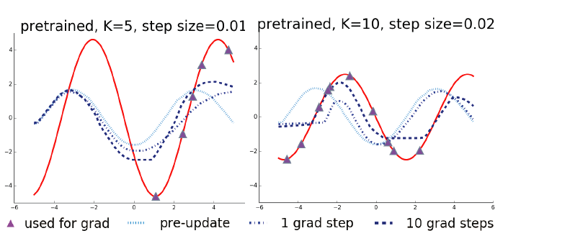
Regression

Slide 15
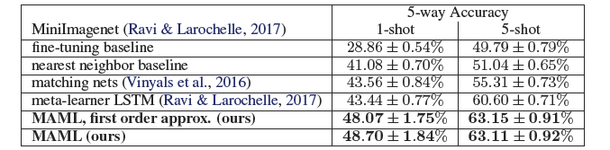
Classification

Slide 16
Reinforcement Learning

Slide 17
Q&A

